Slide 1
Tippe Top Motion
Pranav Joneja
Computational Physics
Spring 2017

Slide 2
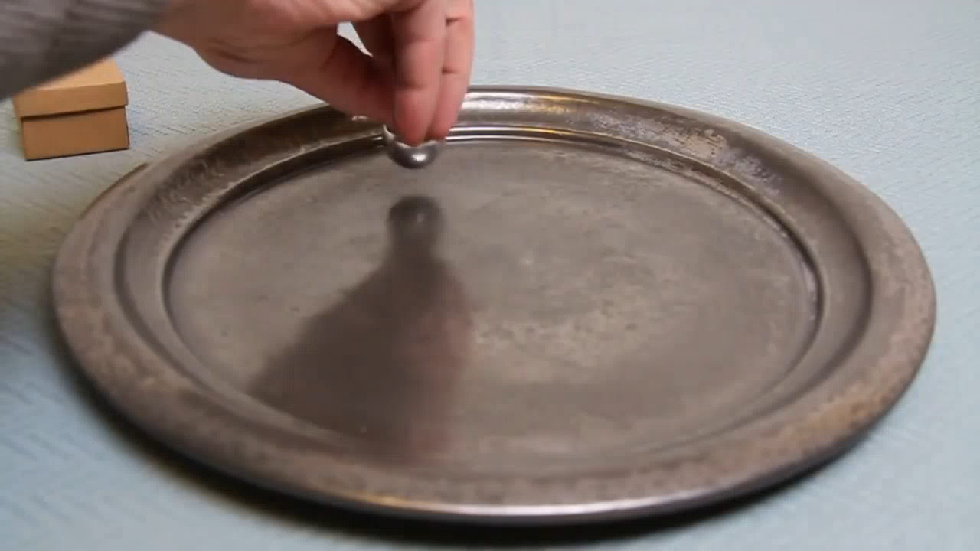

Slide 3
Project Aim:
To produce an animation of a tippe top using numerical methods

Slide 4
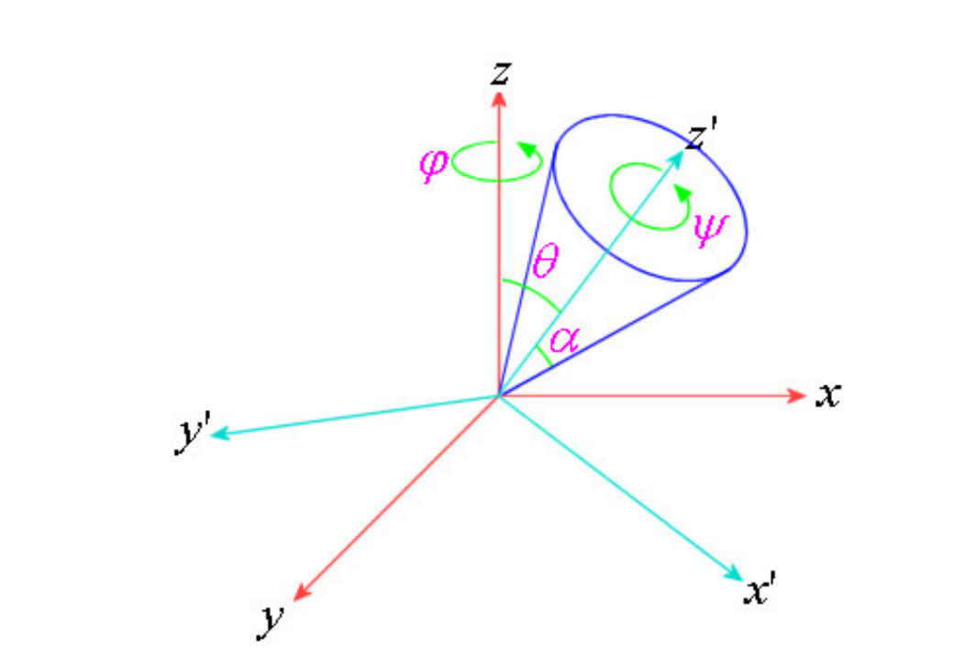
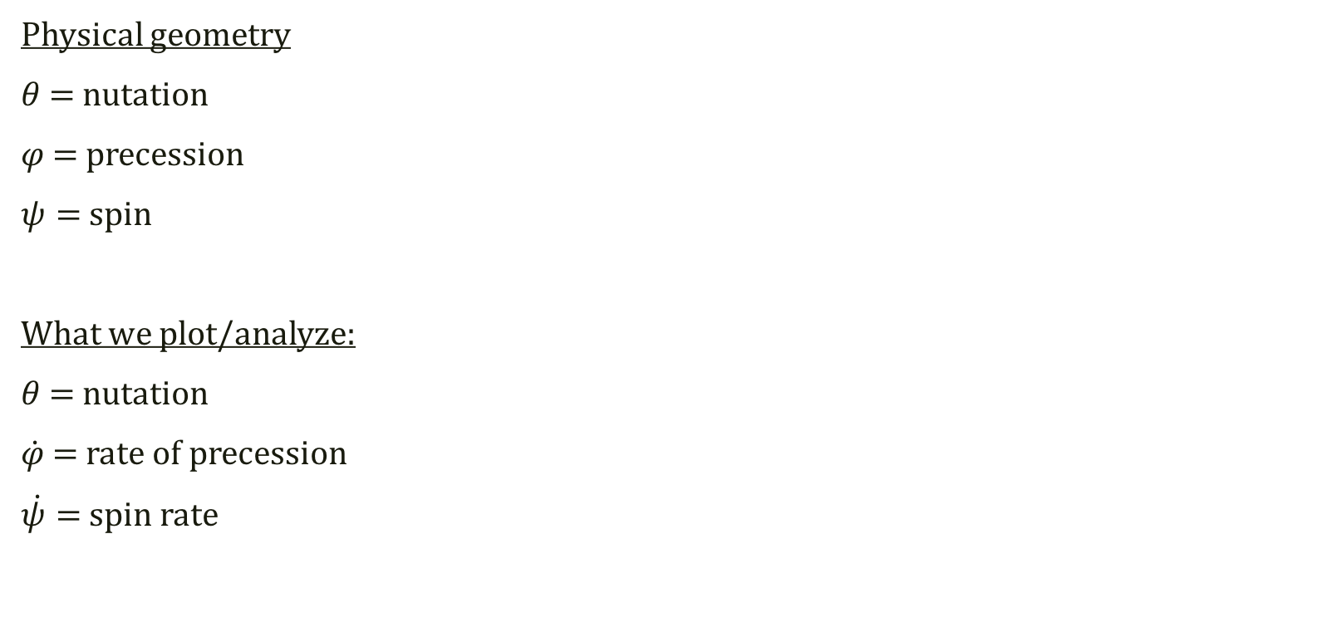
Euler Angles and reference frames
Physical geometry
$θ$ = nutation
$φ$ = precession
$ψ=$ spin
What we plot/analyze:
$θ$ = nutation
$\dot{φ}$ = rate of precession
$\dot{ψ}=$ spin rate

Slide 5
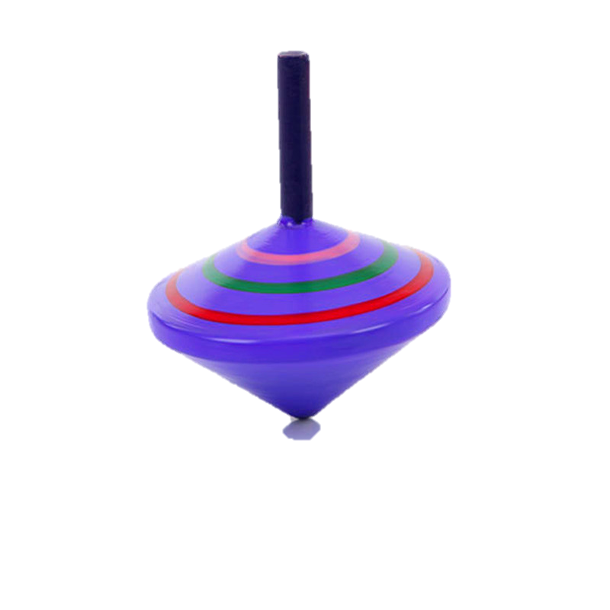
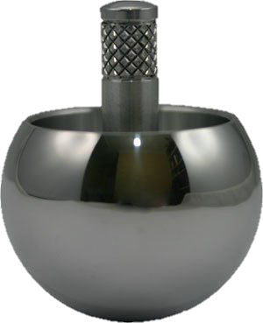
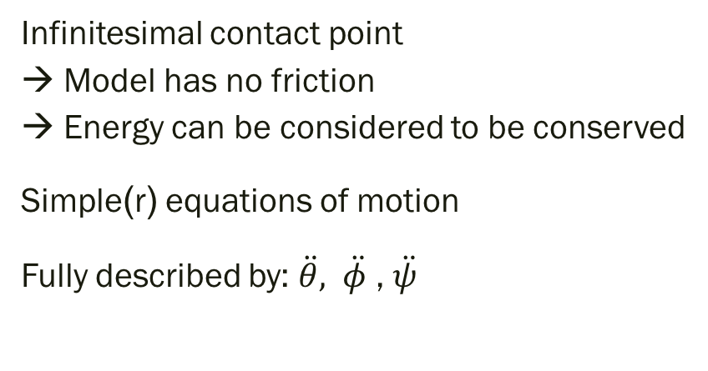
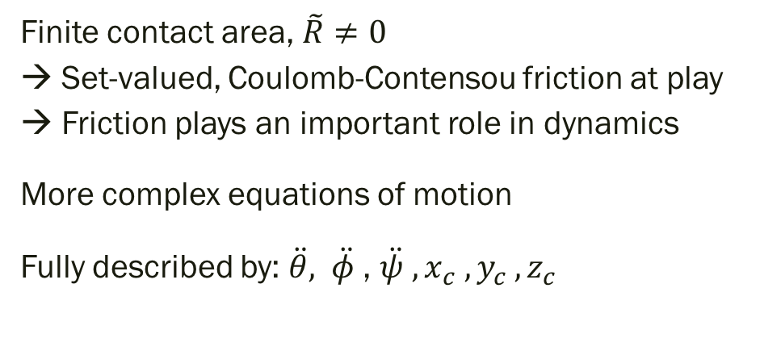
‘Simple’ spinning top
Tippe
top
Infinitesimal contact point → Model has no friction → Energy can be considered to be conserved
Simple(r) equations of motion
Fully described by: $\ddot{θ},$ $\ddot{φ}$ , $\ddot{ψ}$
Finite contact area, $\tilde{R}≠0$ → Set-valued, Coulomb-Contensou friction at play → Friction plays an important role in dynamics
More complex equations of motion
Fully described by: $\ddot{θ},$ $\ddot{φ}$ , $\ddot{ψ} , x_{c} , y_{c} , z_{c}$

Slide 6
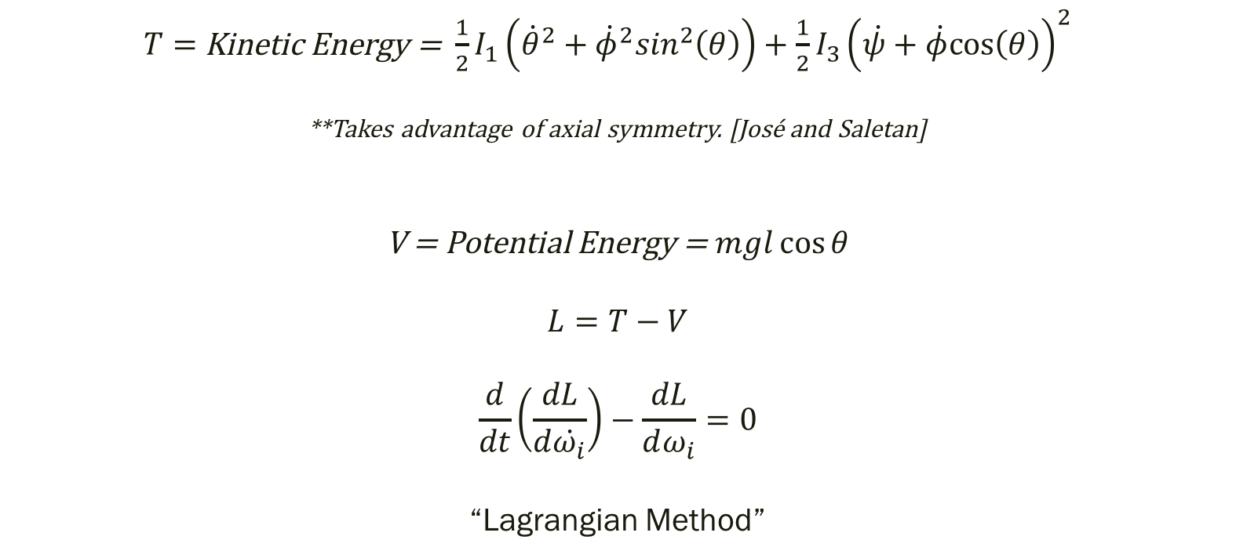
Derivation of Equations of Motion — Lagrangian Method
Simple spinning top
$T=$Kinetic Energy = $\frac{1}{2}I_{1}\left({\dot{θ}}^{2}+{\dot{φ}}^{2}\sin^{2}\left(θ\right)\right)+\frac{1}{2}{I_{3}\left(\dot{ψ}+\dot{φ}cos\left(θ\right)\right)}^{2} ⁡$
**Takes advantage of axial symmetry. [José and Saletan]
V = Potential Energy = $mgl\cos{θ}$
$$L=T−V$$
$$\frac{d}{dt}\left(\frac{dL}{d\dot{ω_{i}}}\right)−\frac{dL}{dω_{i}}=0$$
“Lagrangian Method”

Slide 7
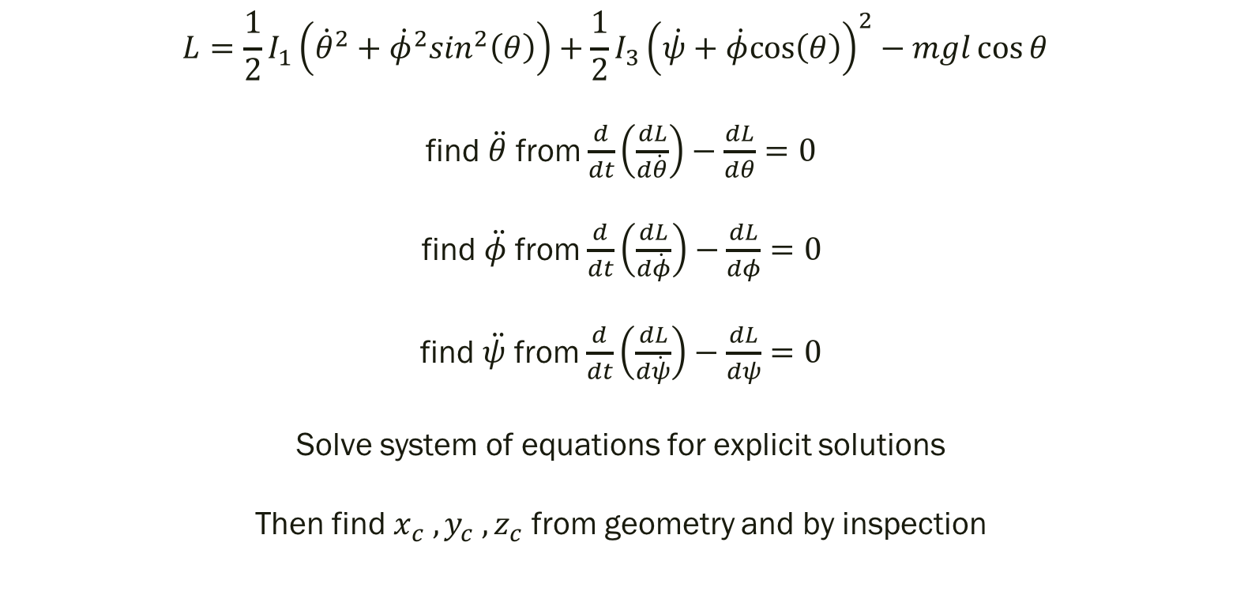
Derivation of Equations of Motion — Lagrangian Method
Simple spinning top
$$L=\frac{1}{2}I_{1}\left({\dot{θ}}^{2}+{\dot{φ}}^{2}\sin^{2}\left(θ\right)\right)+\frac{1}{2}{I_{3}\left(\dot{ψ}+\dot{φ}cos\left(θ\right)\right)}^{2}−mgl\cos{θ}⁡$$
find $\ddot{θ}$ from $\frac{d}{dt}\left(\frac{dL}{d\dot{θ}}\right)−\frac{dL}{dθ}=0$
find $\ddot{φ}$ from $\frac{d}{dt}\left(\frac{dL}{d\dot{φ}}\right)−\frac{dL}{dφ}=0$
find $\ddot{ψ}$ from $\frac{d}{dt}\left(\frac{dL}{d\dot{ψ}}\right)−\frac{dL}{dψ}=0$
Solve system of equations for explicit solutions
Then find $x_{c} , y_{c} , z_{c}$ from geometry and by inspection
{

Slide 8
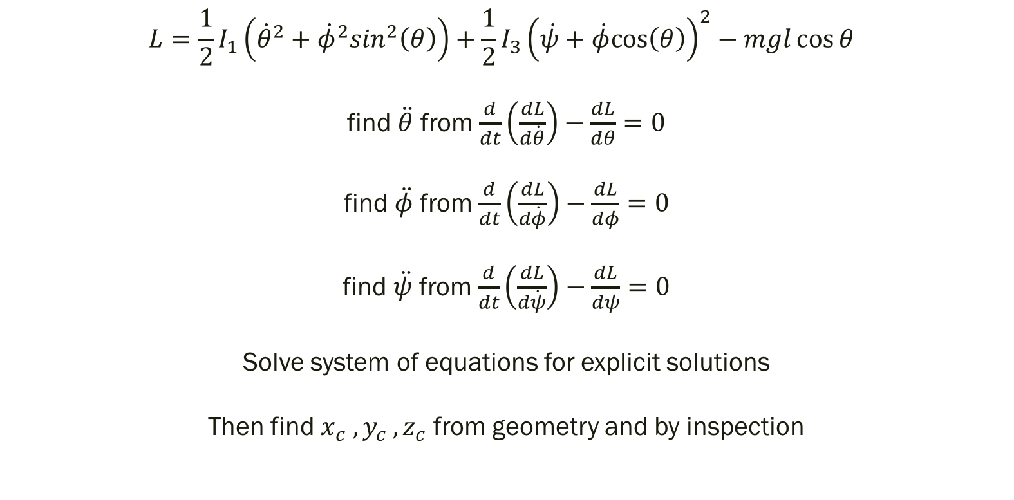
Derivation of Equations of Motion — Lagrangian Method
Simple spinning top
Initial Conditions
$$L=\frac{1}{2}I_{1}\left({\dot{θ}}^{2}+{\dot{φ}}^{2}\sin^{2}\left(θ\right)\right)+\frac{1}{2}{I_{3}\left(\dot{ψ}+\dot{φ}cos\left(θ\right)\right)}^{2}−mgl\cos{θ}⁡$$
find $\ddot{θ}$ from $\frac{d}{dt}\left(\frac{dL}{d\dot{θ}}\right)−\frac{dL}{dθ}=0$
find $\ddot{φ}$ from $\frac{d}{dt}\left(\frac{dL}{d\dot{φ}}\right)−\frac{dL}{dφ}=0$
find $\ddot{ψ}$ from $\frac{d}{dt}\left(\frac{dL}{d\dot{ψ}}\right)−\frac{dL}{dψ}=0$
Solve system of equations for explicit solutions
Then find $x_{c} , y_{c} , z_{c}$ from geometry and by inspection
Set up equations
{
ODE solve with RK4
Transform coordinates with matrix multiplication

Slide 9
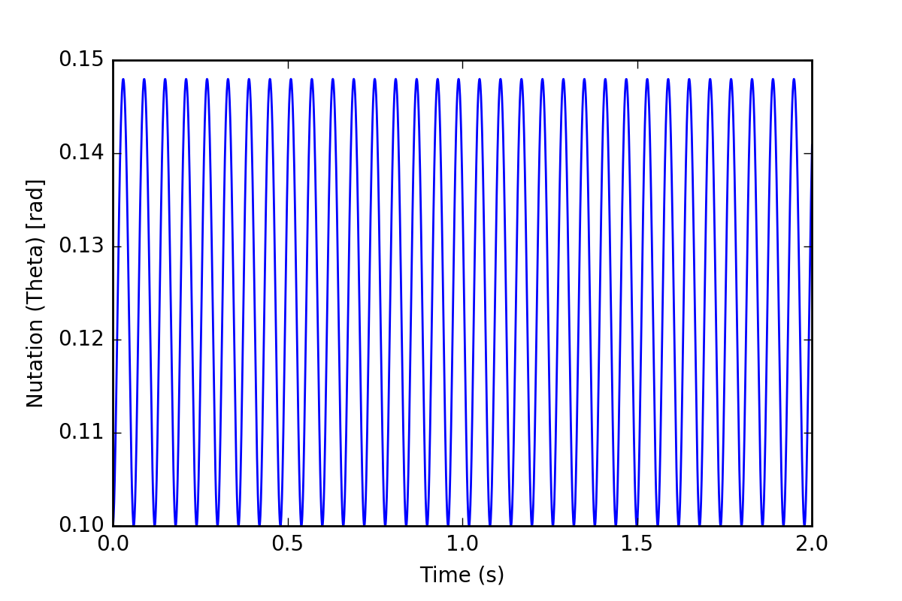
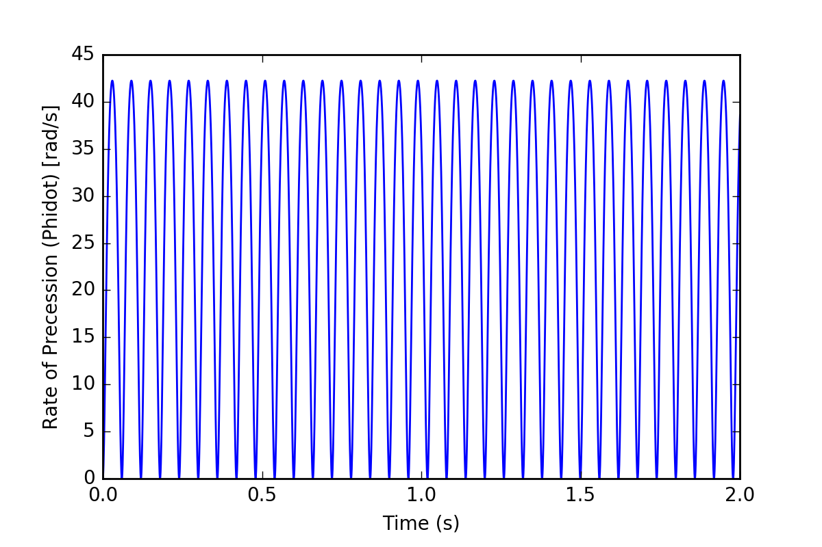
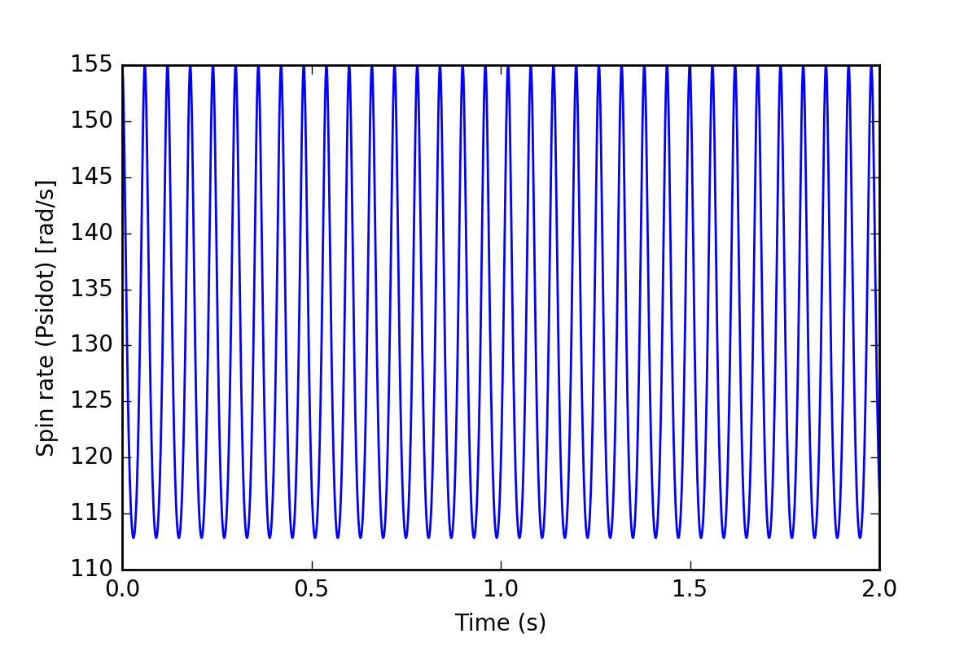
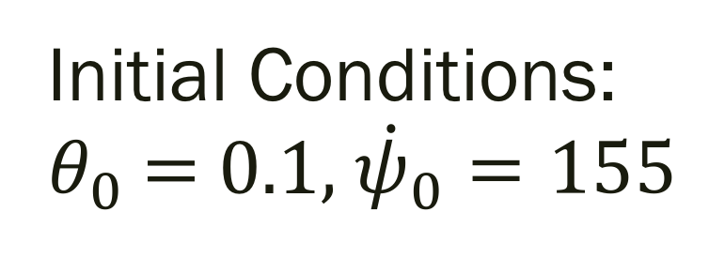
Simple spinning top
Initial Conditions: $θ_{0}$ = 0.1, ${\dot{ψ}}_{0}=155$

Slide 10
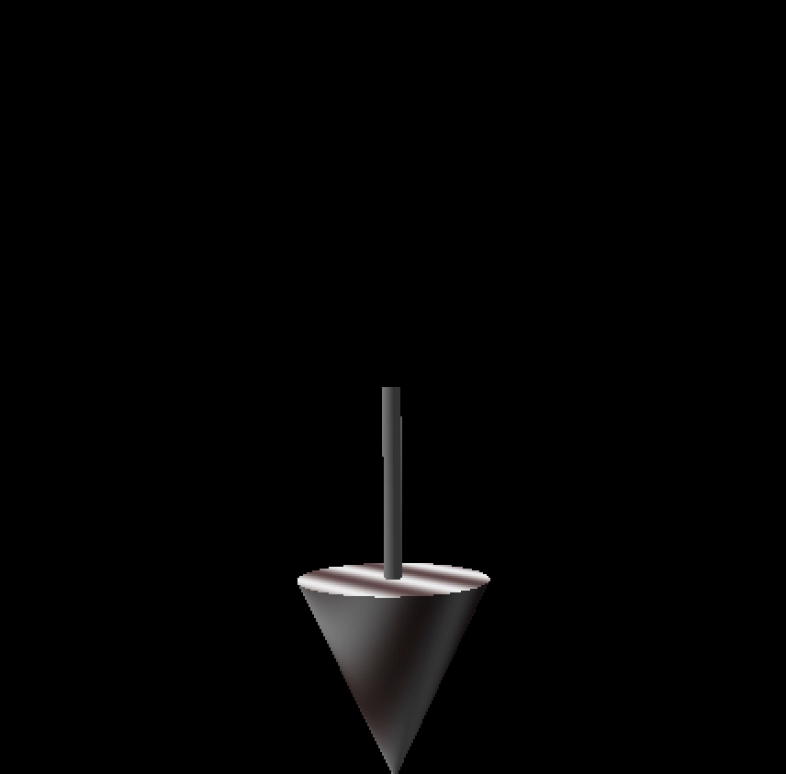

Slide 11
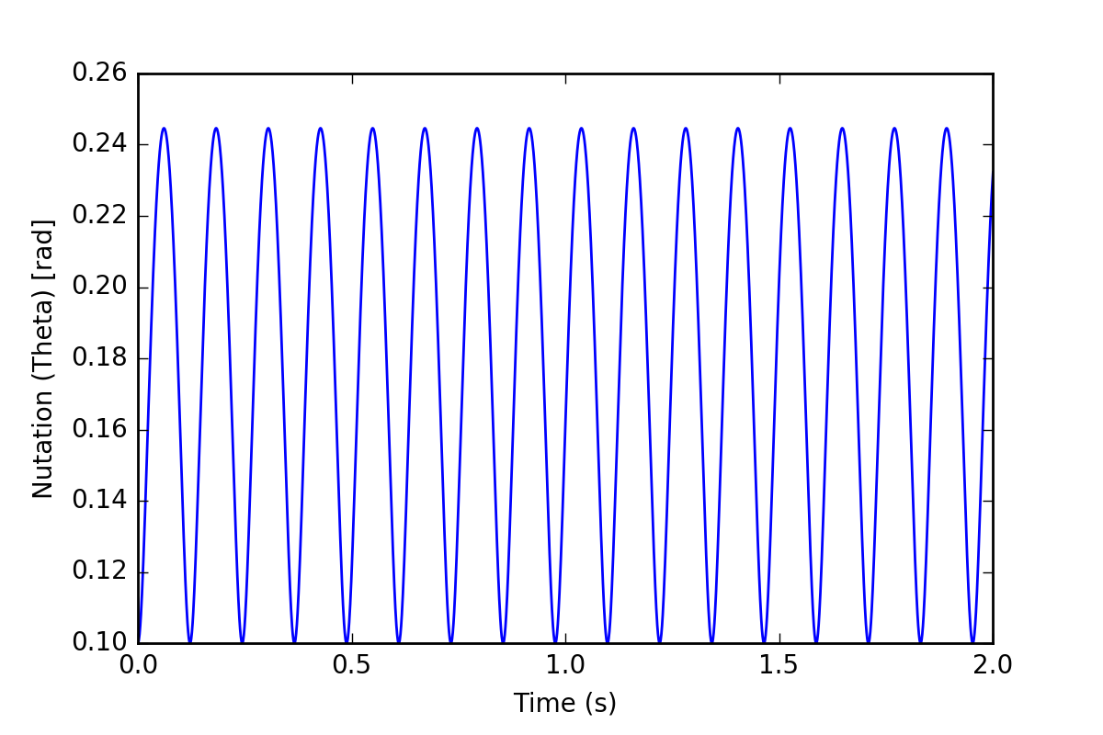
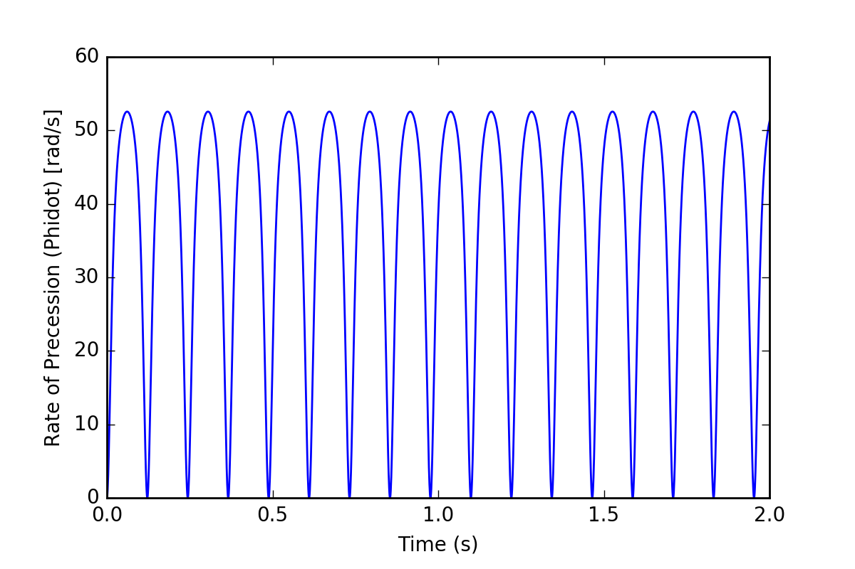
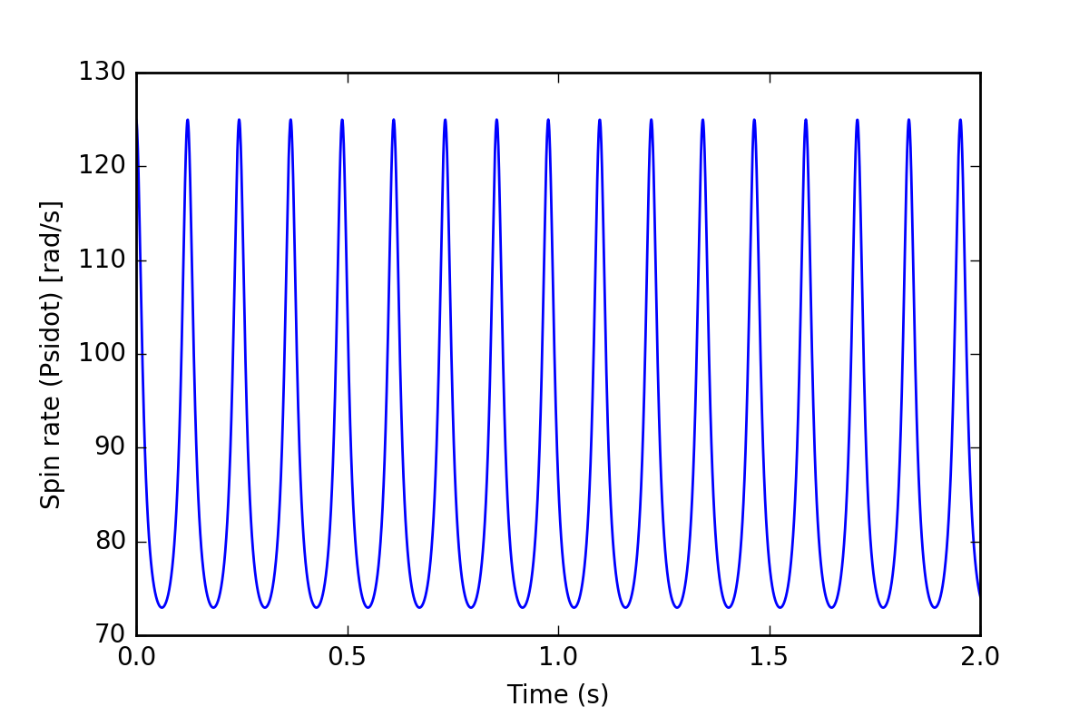
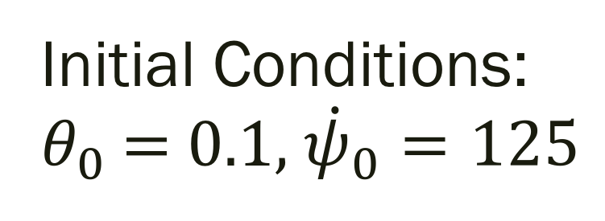
Simple spinning top
Initial Conditions: $θ_{0}$ = 0.1, ${\dot{ψ}}_{0}=125$

Slide 12
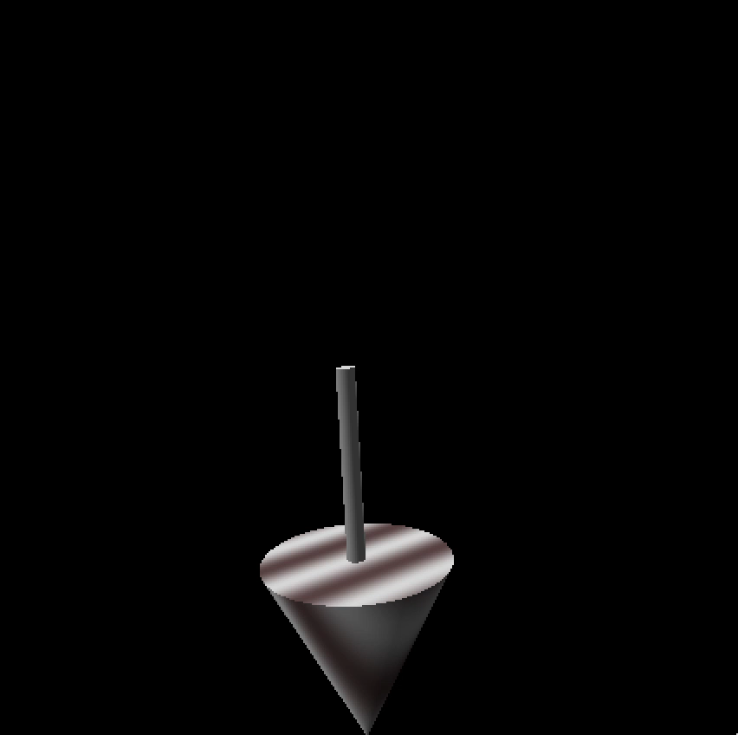

Slide 13
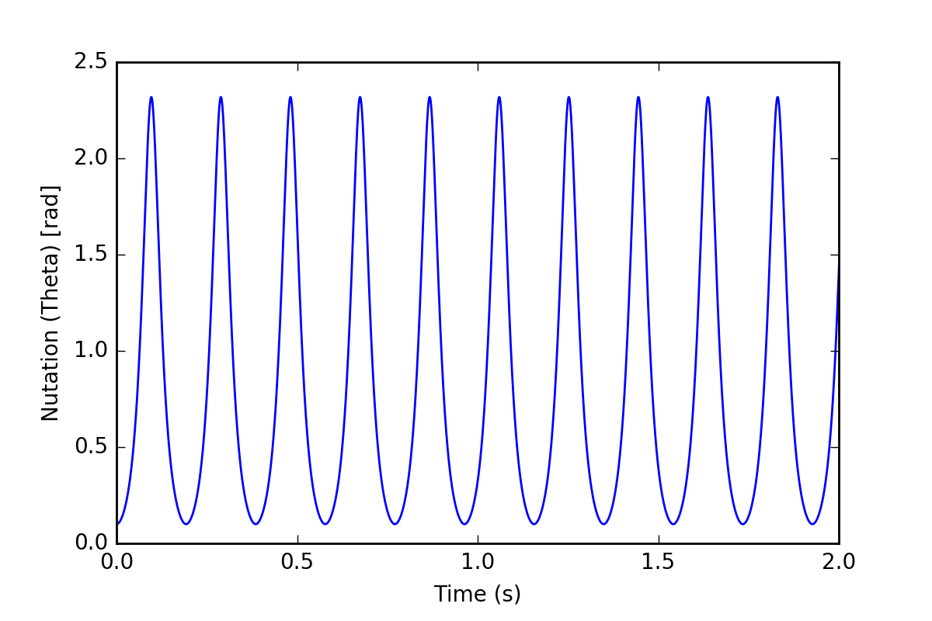
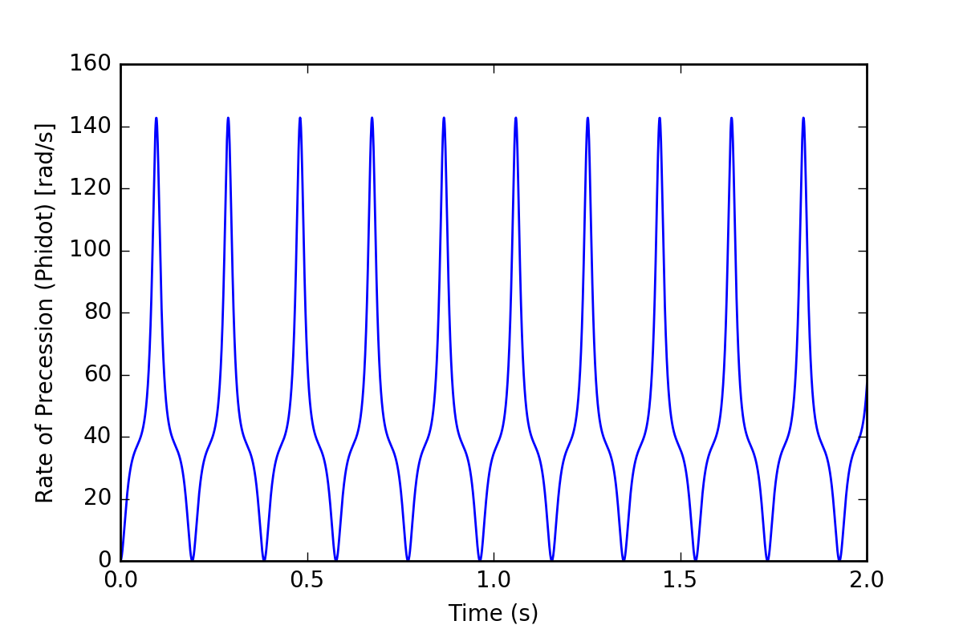
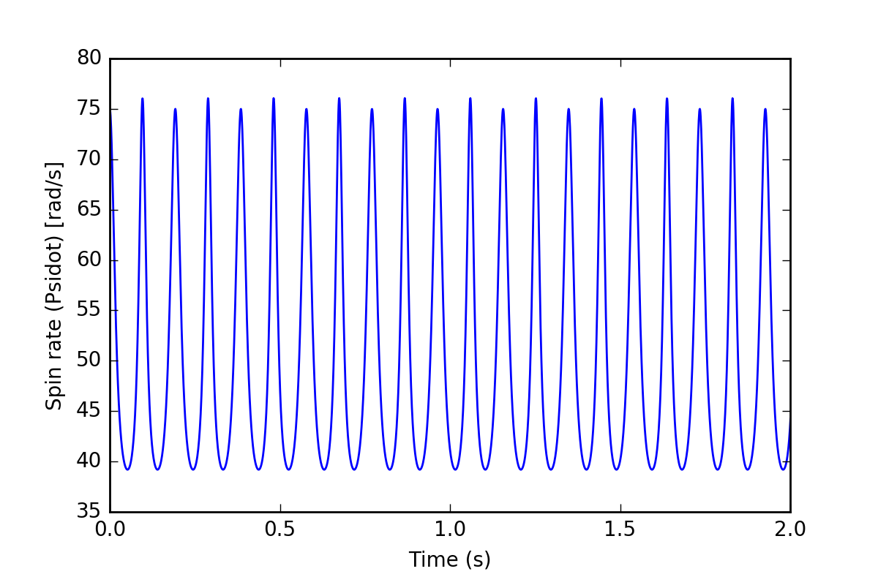
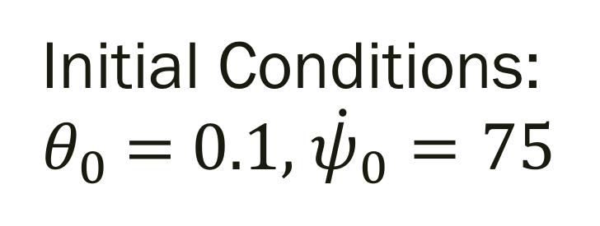
Simple spinning top
Initial Conditions: $θ_{0}$ = 0.1, ${\dot{ψ}}_{0}=75$

Slide 14
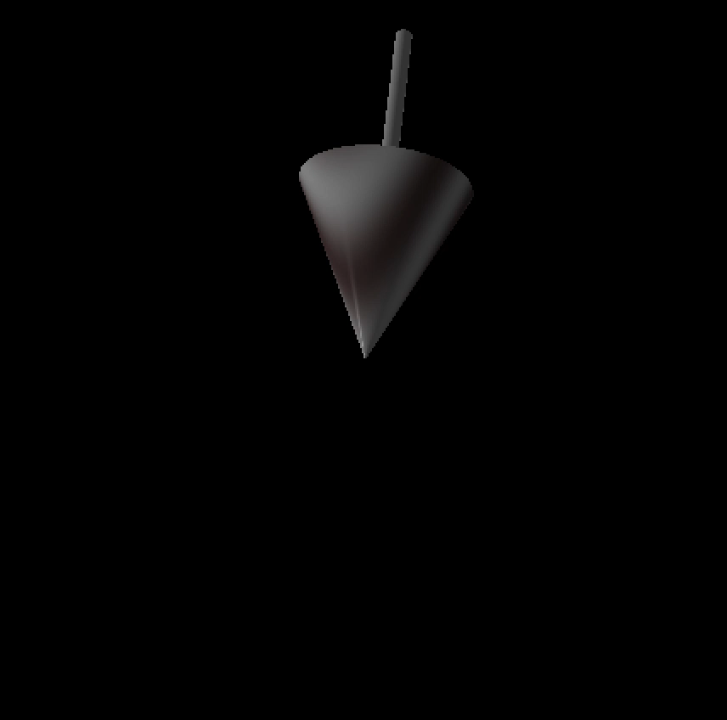

Slide 15
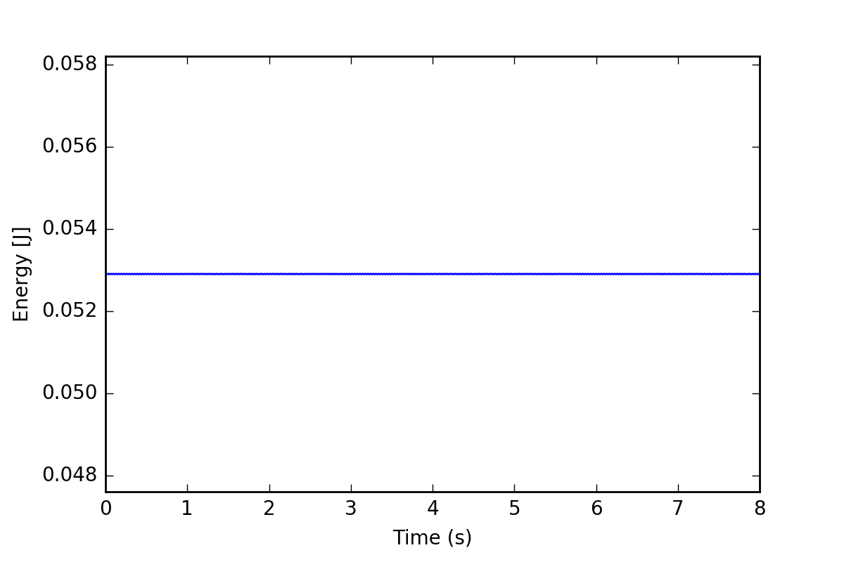
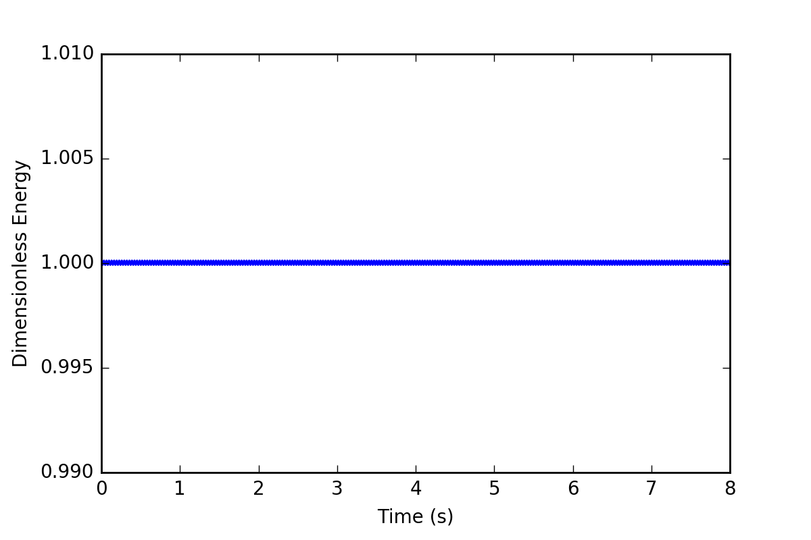
Simple spinning top
1) Energy
2) Dimensionless Energy is normalized by initial energy

Slide 16
Tippe Top – Energy Transformations
Experimentally, we can observe that:
The top does invert
Center of mass starts ‘low’ and ends ‘high’
→ this implies increase in potential energy
Before inversion: fast rate of spin
After inversion: low rate of spin
this implies decrease in kinetic energy
Energy transformed from kinetic energy to potential energy
Indicates that Lagrangian is the method of choice
BUT ENERGY IS NOT CONSERVED!

Slide 17
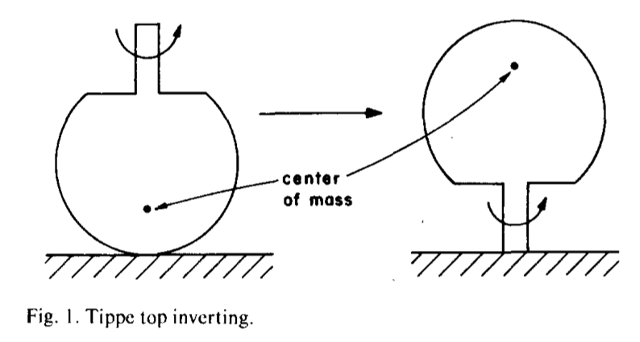
Evidence of effects of friction
In the tippe top reference frame, angular momentum has reversed direction
To change angular momentum, a torque must be applied
This torque cannot be from gravity or inertia → must be from friction
[Cohen, 1977]

Slide 18
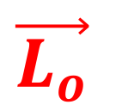
Evidence of effects of friction
$$\vec{L_{o}}$$
In the tippe top reference frame, angular momentum has reversed direction
To change angular momentum, a torque must be applied
This torque cannot be from gravity or inertia → must be from friction
[Cohen, 1977]

Slide 19
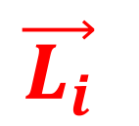
Evidence of effects of friction
$$\vec{L_{o}}$$
$$\vec{L_{i}}$$
In the tippe top reference frame, angular momentum has reversed direction
To change angular momentum, a torque must be applied
This torque cannot be from gravity or inertia → must be from friction
[Cohen, 1977]

Slide 21
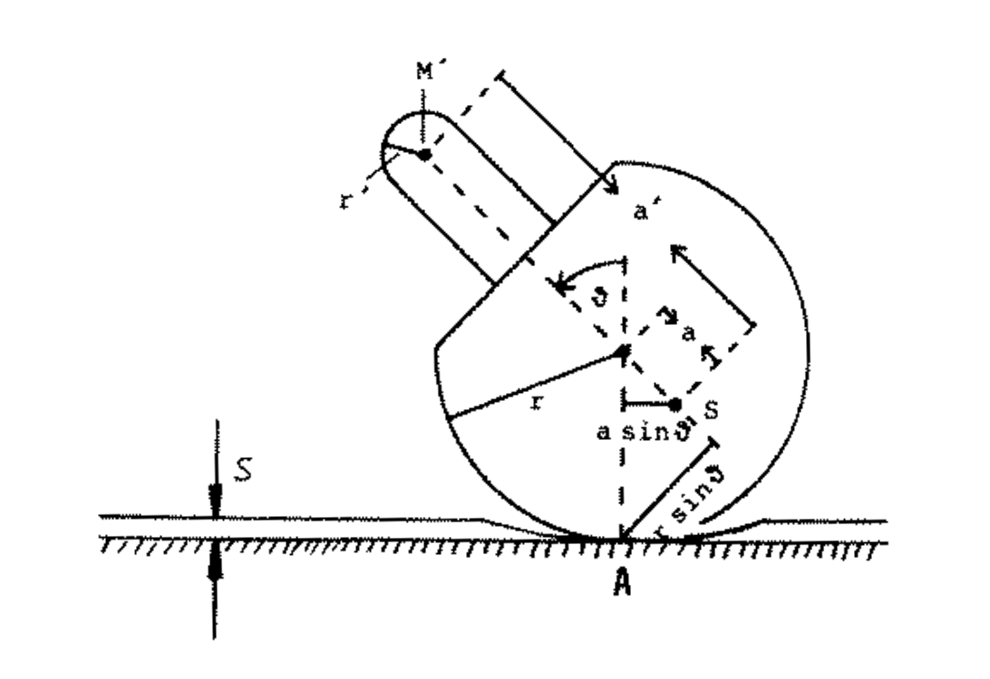
[Friedl 1997]

Slide 22
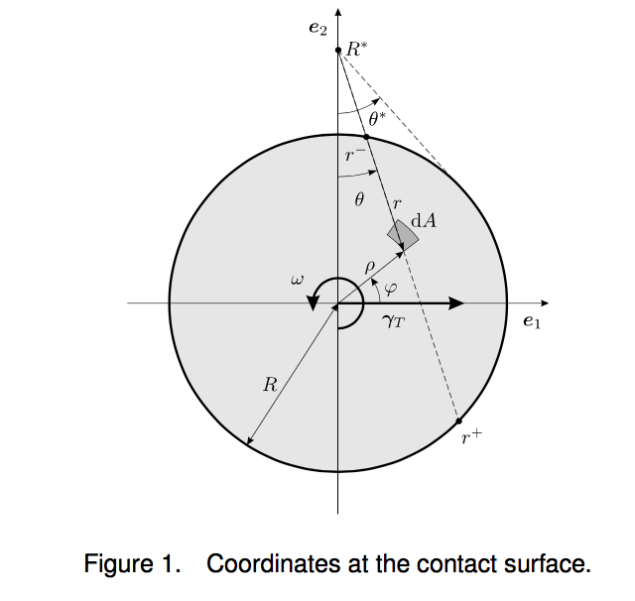
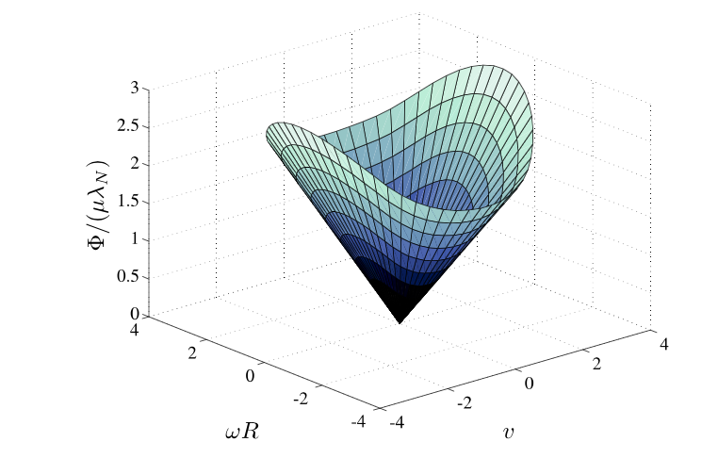
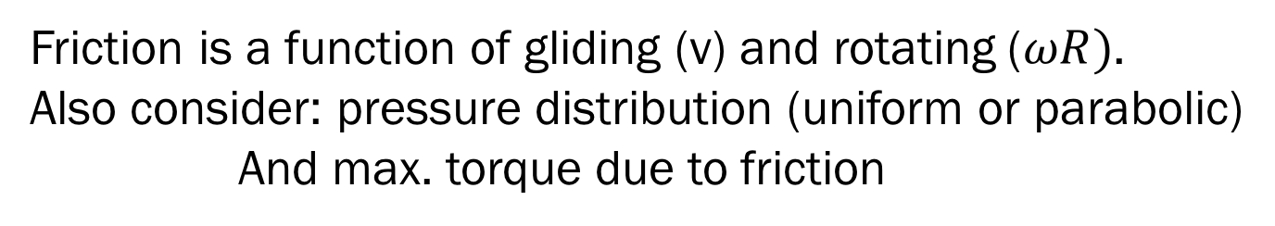
Set-valued, Coulomb-Contensou friction
Friction is a function of gliding (v) and rotating ($ωR)$.
Also consider: pressure distribution (uniform or parabolic)
And max. torque due to friction
[Leine and Glocker, 2003]

Slide 23
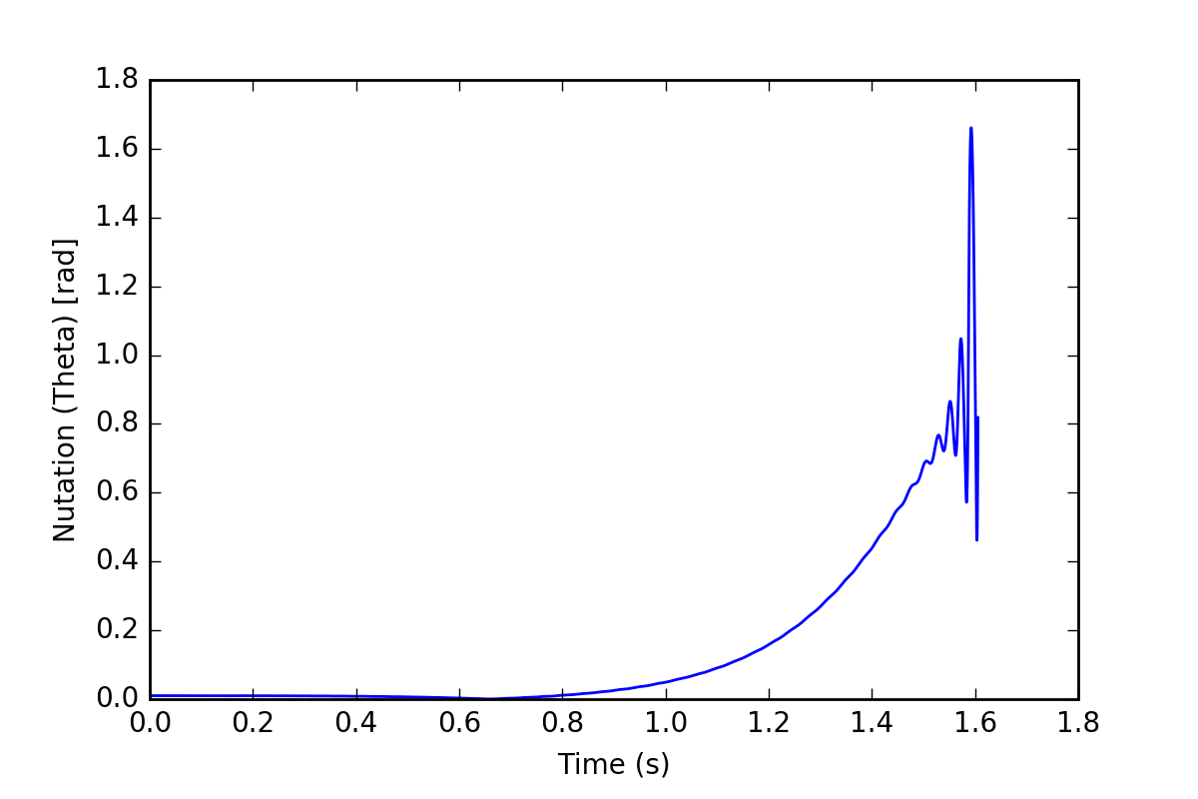
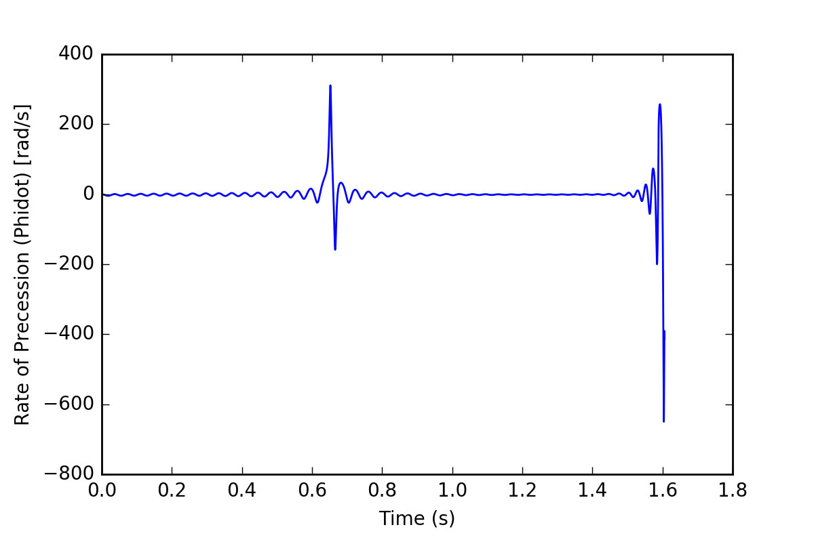
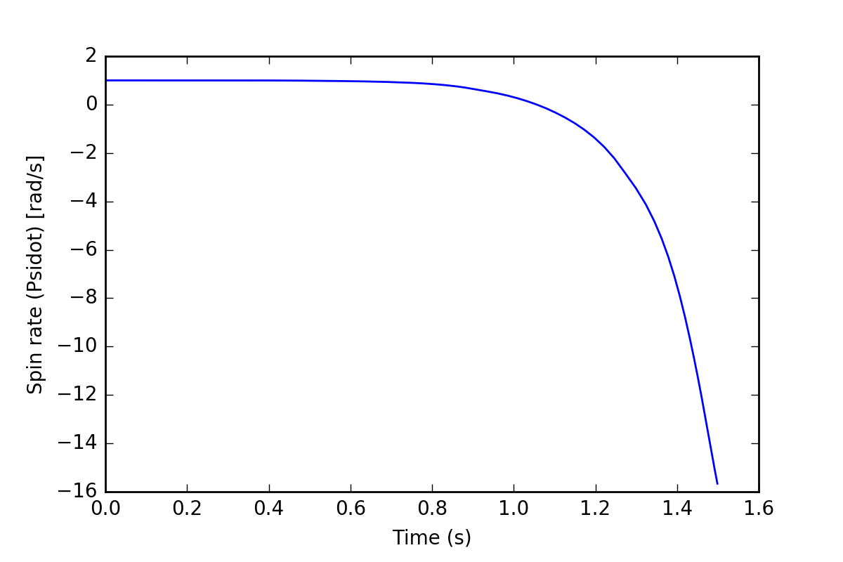
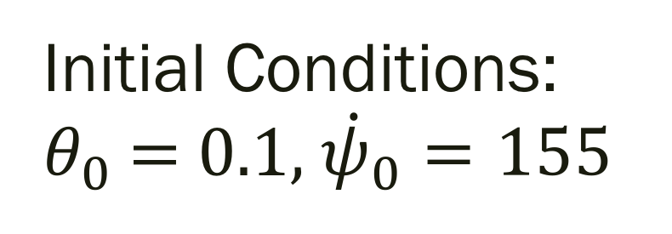
Tippe top
Initial Conditions: $θ_{0}$ = 0.1, ${\dot{ψ}}_{0}=155$

Slide 24
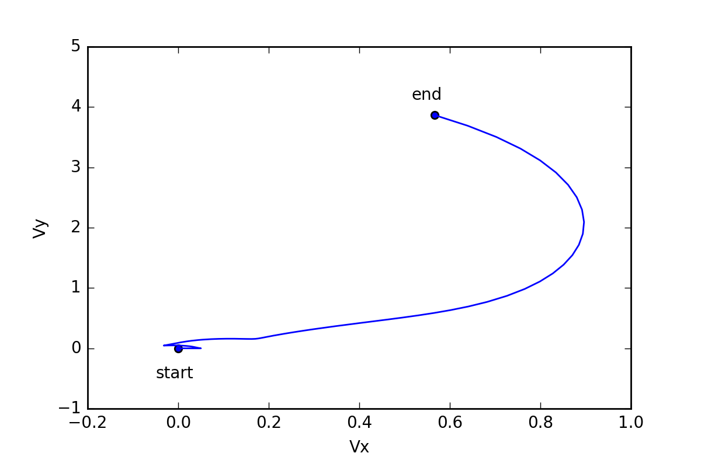

Slide 25
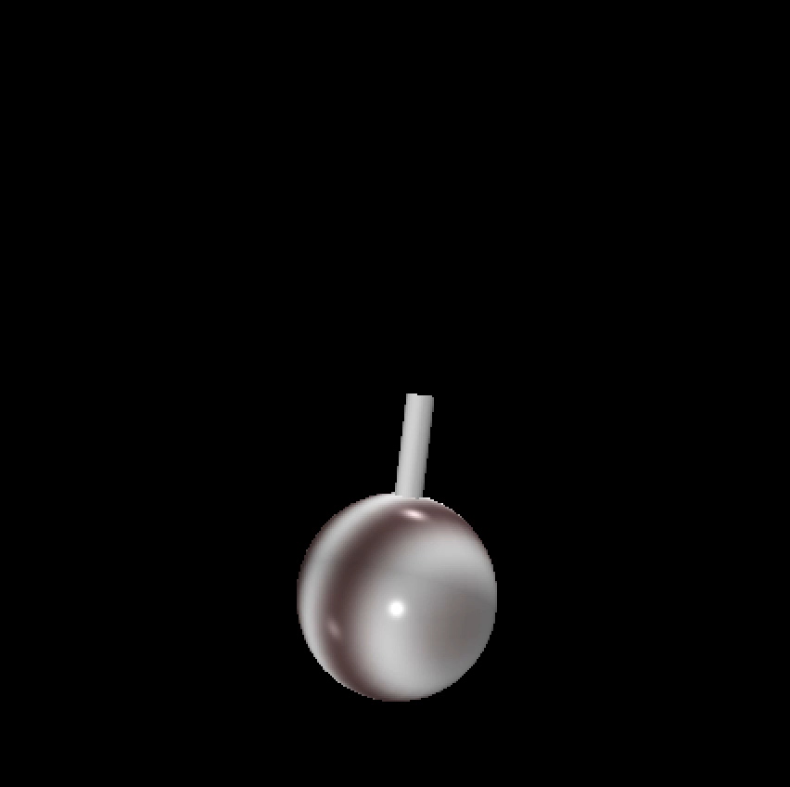

Slide 26
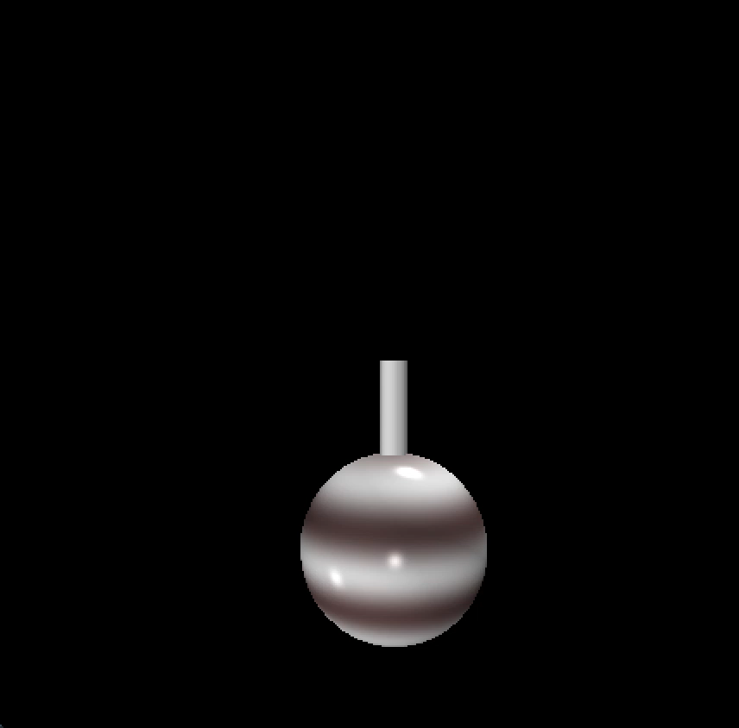

Slide 27
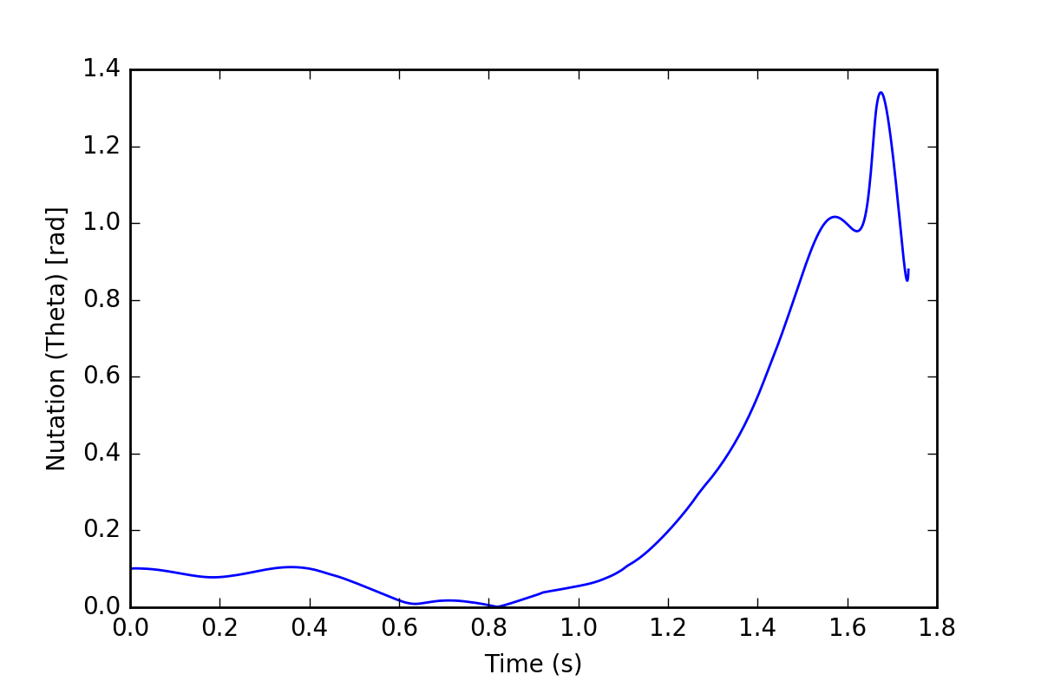
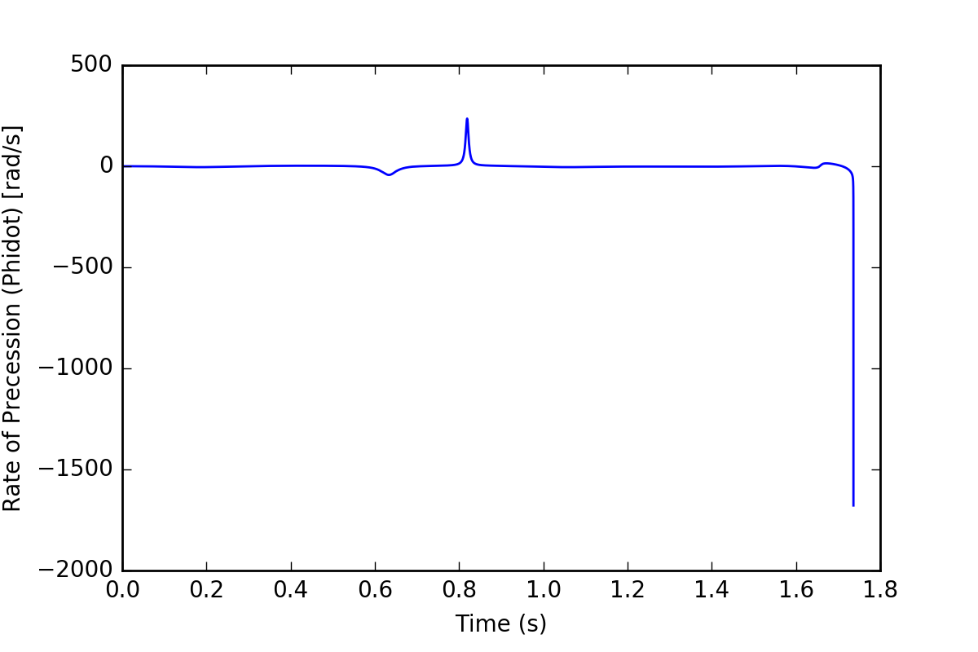
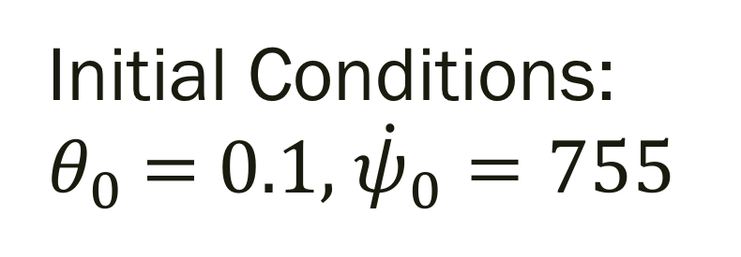
Tippe top
Initial Conditions: $θ_{0}$ = 0.1, ${\dot{ψ}}_{0}=755$

Slide 28
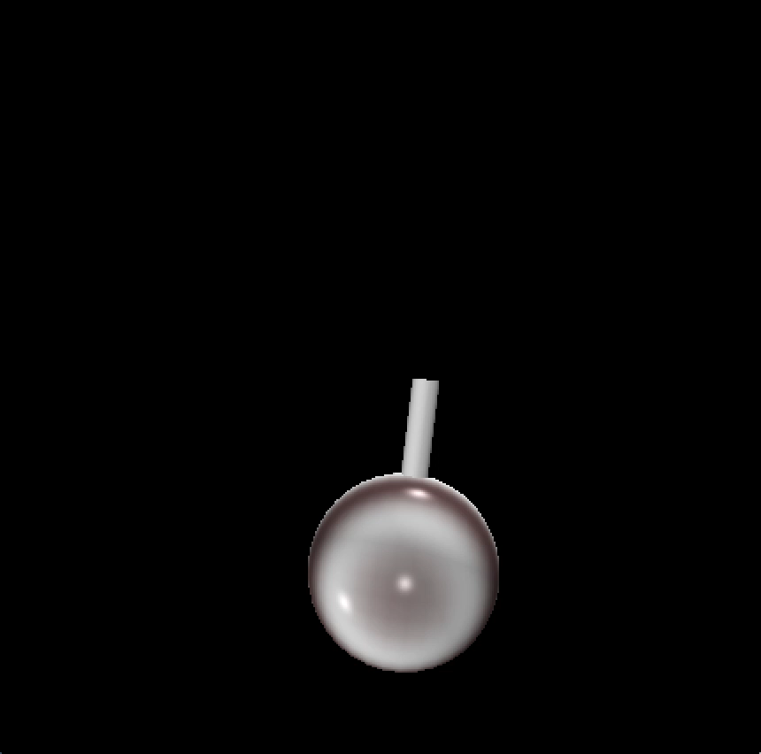

Slide 29
References
José, Jorge Valenzuela, and Eugene Jerome Saletan. Classical Dynamics: A Contemporary Approach. Cambridge: Cambridge UP, 2013. Print.
Cohen, Richard J. "The Tippe Top Revisited." American Journal of Physics 45.12 (1977): 12-17.
Friedl, Christian. “Der Stehaufkreisel.” Universität Augsburg, Institut für Physik. 1997
Leine, Remco I., and Christoph Glocker. "A Set-Valued Force Law for Spatial Coulomb-Contensou Friction." Volume 5: 19th Biennial Conference on Mechanical Vibration and Noise, Parts A, B, and C (2003): n. pag. Web.

